Slide 2
From Community to Cloud with F#
@dsyme – Microsoft Research
@isaac_abraham – Compositional IT

Slide 3
Cloud, Cloud, Cloud
Open Source
Cross-platform
Bring Your Own Editor
Heterogeneous Devices
Data and Scale
Empowered
Communities
Multi-contributor
Technologies

Slide 4
What Kind of Language Design? What Kind of Language Community? What Kind of Language Technologies?

Slide 5
Language
Design
Language Tech
Language
Culture

Slide 6
The F# Community …and why it is so awesome

Slide 7
TL;DR
F# is open, cross-platform, neutral, independent
The F# Compiler Service powers many other tools
F# 4.0 now complete!
Debian packages, Docker containers and more for Linux
The F# language is accepting contributions
The F# community is very “self-empowered”
fsharp.org
The Visual F# Tools are Microsoft’s professional tools for Windows and Azure
Xamarin provide F# tools Android and iOS

Slide 8
Example #1 (power company)
We have written an application to balance the national power generation schedule … for an energy company.
...the calculation engine was written in F#.
The use of F# to address the complexity at the heart of this application clearly demonstrates a sweet spot for the language … algorithmic analysis of large data sets.
Simon Cousins (UK Power Company)

Slide 9
Example #1 (power company)
Time to Market
Efficiency
Interoperation ... Seamless. The C# programmer need never know.
Strong typing … a huge time saver...it eradicates a whole class of errors…
Exploratory programming …Working with F# Interactive allowed me to explore the solution space more effectively.
Unit testing …a joy to test. There are no complex time-dependent interactions to screw things up….
Parallelism …The functional purity ... makes it ripe for exploiting the inherent parallelism in processing vectors of data.
Code reduction… … vectors and matrices…higher order functions eat these for breakfast with minimal fuss, minimal code. Beautiful.
Lack of bugs… Functional programming can feel strange. .. once the type checker is satisfied that’s often it, it works.
Correctness
Time to Market
Time to Market
Correctness
Correctness

Slide 10
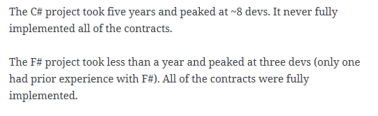
Example #1 (Simon Cousins, Energy Sector)
350,000
lines of C# OO
by offshore team
30,000
lines of robust F#, with
parallel +more features
An application to evaluate the revenue due from Balancing Services contracts in the UK energy industry
http://simontcousins.azurewebsites.net/does-the-language-you-use-make-a-difference-revisited/

Slide 11
Example #1 (Simon Cousins, Energy Sector)
Zero
bugs in deployed system
“F# is the safe choice for this project,
any other choice is too risky”
An application to evaluate the revenue due from Balancing Services contracts in the UK energy industry
http://simontcousins.azurewebsites.net/does-the-language-you-use-make-a-difference-revisited/

Slide 12
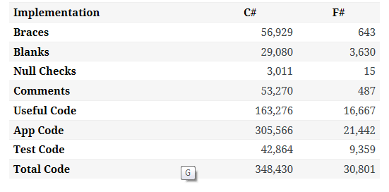

Slide 13
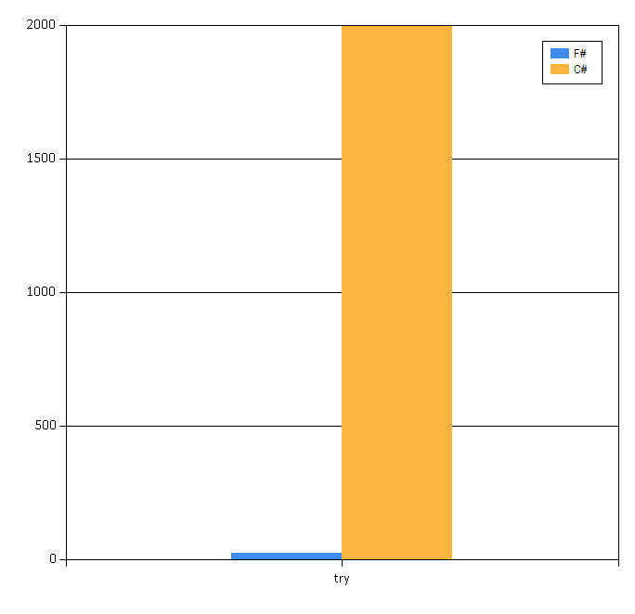

Slide 14
Example #2: F# for Cloud Social Gaming
Efficiency
F# is becoming an increasingly important part of our server side infrastructure that supports our mobile and web-based social games with millions of active users. F# first came to prominence in our technology stack in the implementation of the rules engine for our social slots games which by now serve over 700,000 unique players and 150,000,000 requests per day at peaks of several thousand requests per second.
The F# solution offers us an order of magnitude increase in productivity and allows one developer to perform the work that are performed by a team of dedicated developers on an existing Java-based solution, and is critical in supporting our agile approach and bi-weekly release cycles.
Yan Cui, Lead Server Engineer
Time to Market
fsharp.org/testimonials

Slide 15
In 18 months of community-friendly F#... We’ve come a long way!

Slide 16
The F# Compiler – 300+ Pull Requests and rising Where to Contribute? See github.com/Microsoft/visualfsharp

Slide 17
The F# Language Design Process fslang.uservoice.com

Slide 18
F# 4.0 ✔ True shift to cross-platform open engineering ✔ Long laundry list of language items ✔ Normalized core library ✔ Type providers more powerful ✔ Better debugging, tooling, performance ✔ ~20% compiler perf improvement

Slide 19
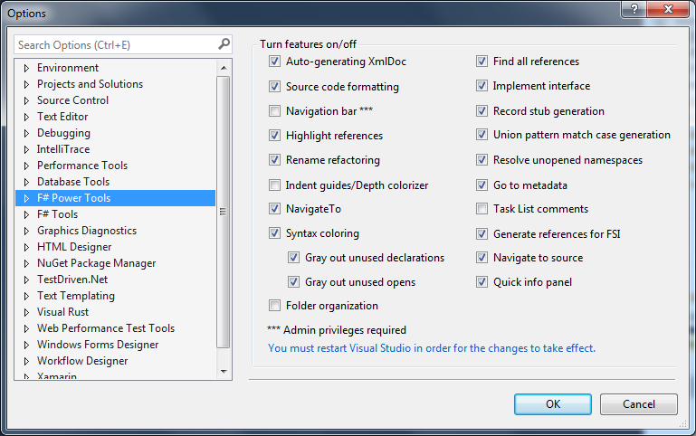
The Visual F# Power Tools
fsprojects.github.io/VisualFSharpPowerTools

Slide 20
F# for Android, iOS, Linux, Mac fsharp.org/use/android fsharp.org/use/ios fsharp.org/use/linux fsharp.org/use/mac

Slide 21
It’s the whole community!

Slide 22

100% open source, community driven

Slide 23
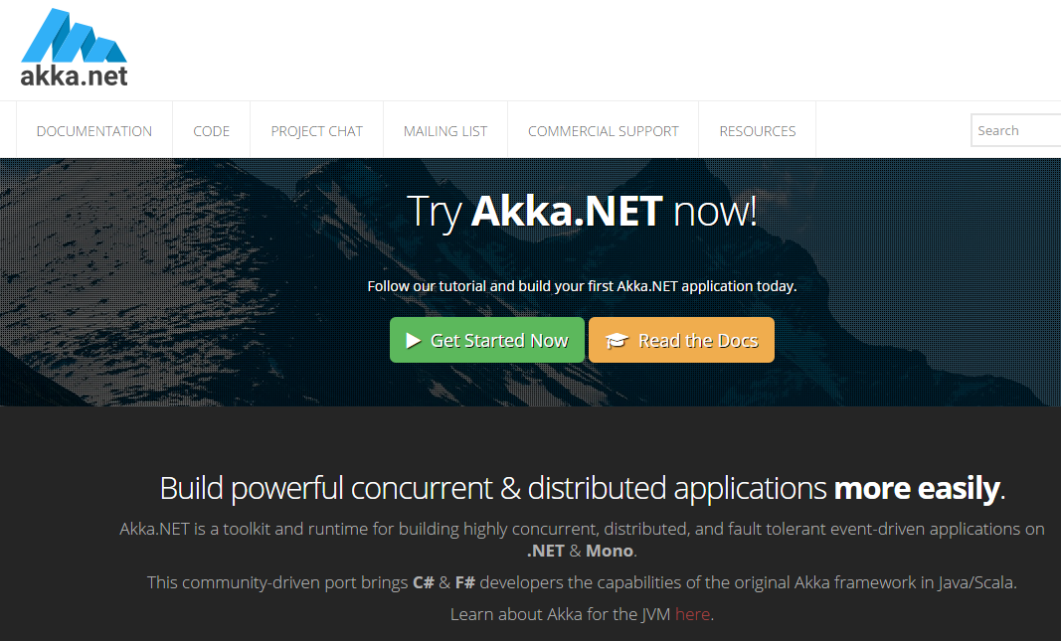
100% open source, community driven

Slide 24
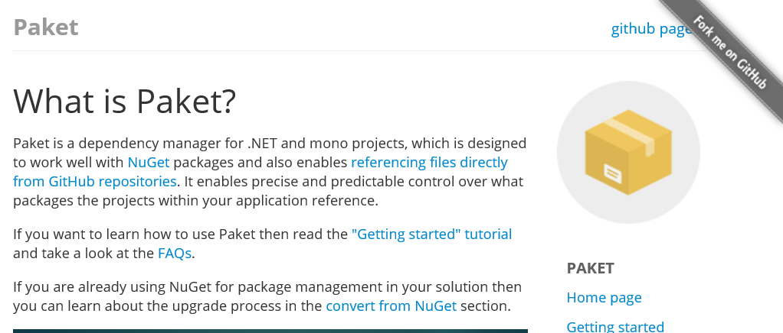
http://fsprojects.github.io/Paket/

Slide 25
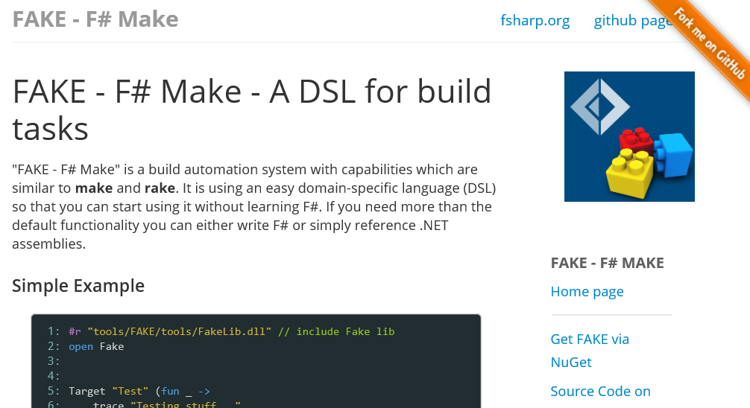
http://fsharp.github.io/FAKE/

Slide 26
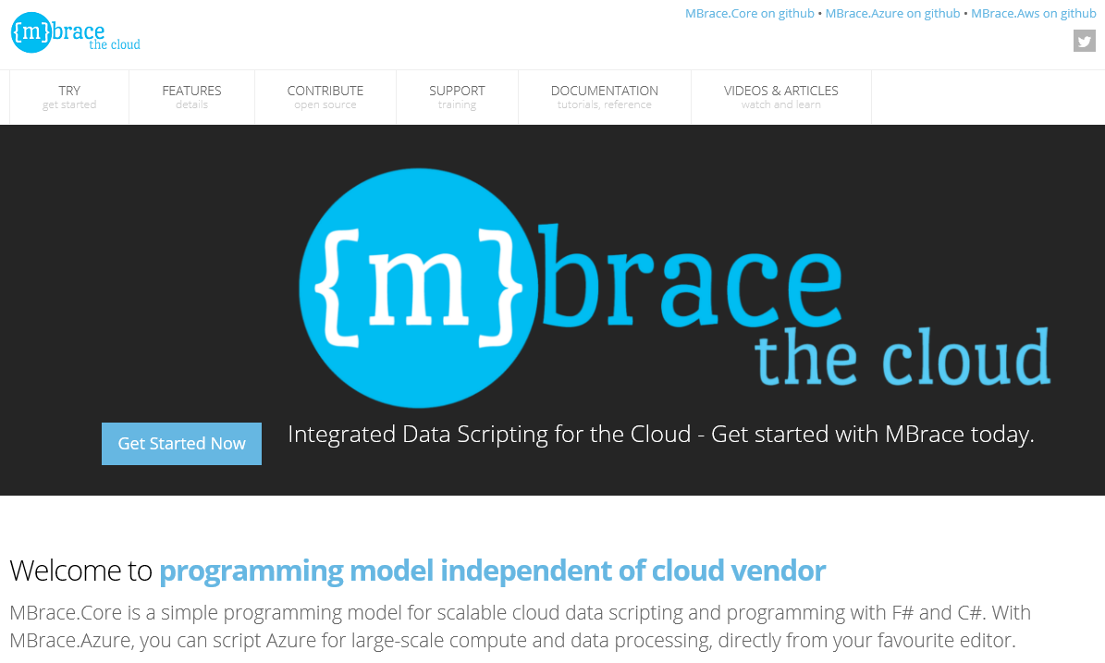
100% open source, community driven
http://mbrace.io/

Slide 27
F# for Docker? Yes! hub.docker.com/fsharp/fsharp

Slide 28
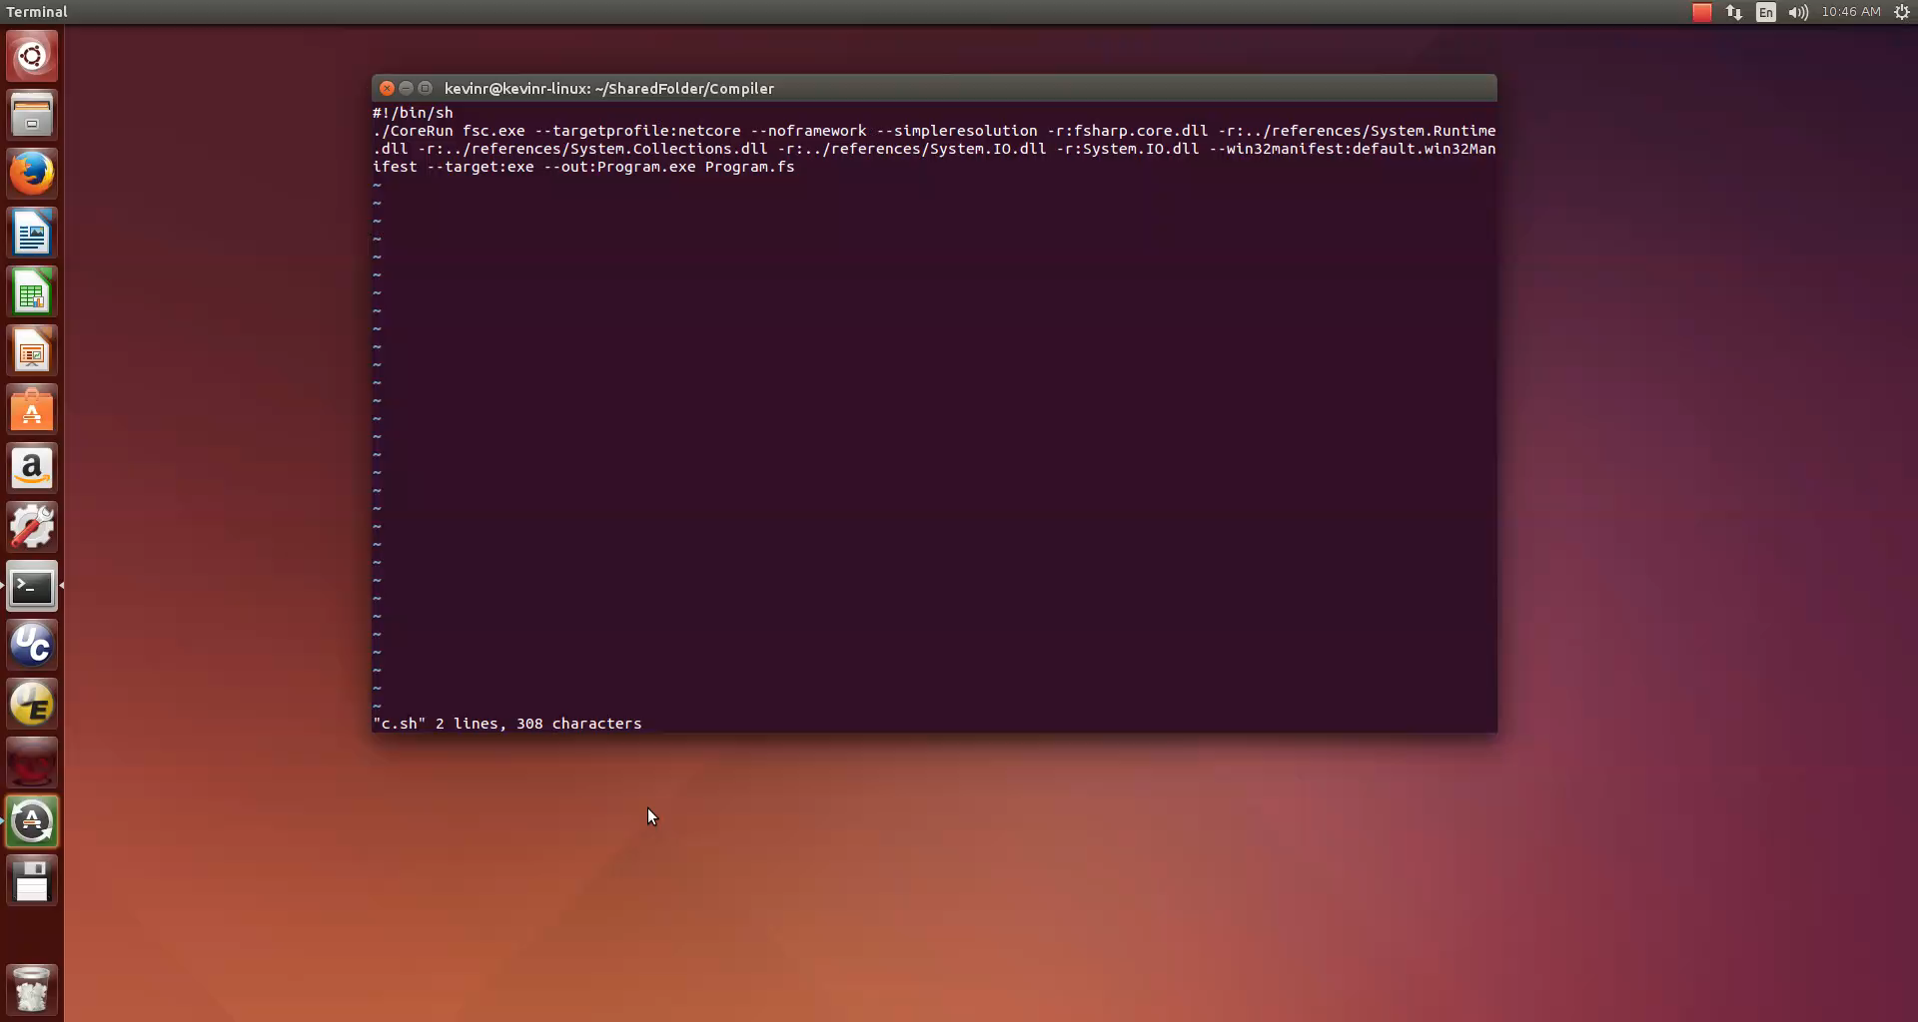
F# for CoreCLR – Yes!

Slide 29
F# for Win10 UWP Apps – “Working on it” WinDev uservoice

Slide 30
Demo – Types From Data

Slide 31
Part 2 – Making Cloud Simple

Slide 32
Cloud Language Design
Functional
Type-providers
Scripting
Async

Slide 33
async { … }
Shared memory
Maps to tasks

Slide 34
cloud { … }
Distribution-ready
No shared memory
Maps to cloud tasks

Slide 35
Demo – MBrace StarterKit
Demo

Slide 36
Lean and Simple
Execution
cluster -- handle to cluster
cloud { … } -- cloud computation
local { … } -- fragment of multi-core cloud computation
Cloud.Parallel, … -- composition
Job control
cluster.CreateProcess -- start a job, asynchronously
cluster.Run -- run a job, synchronously
cluster.GetProcess(“…guid…”) -- fetch a job
job.ShowInfo()/ShowLogs() -- display a job
job.Kill() -- etc.
Data
CloudValue<T> -- handle to immutable blob in cloud storage
CloudFile -- handle to partitioned file in cloud storage
CloudQueue<T> -- handle to partitioned cloud queue
Data Flow
CloudFlow.map/groupBy/filter/sort/… -- compositional cloud-parallel data flow

Slide 37
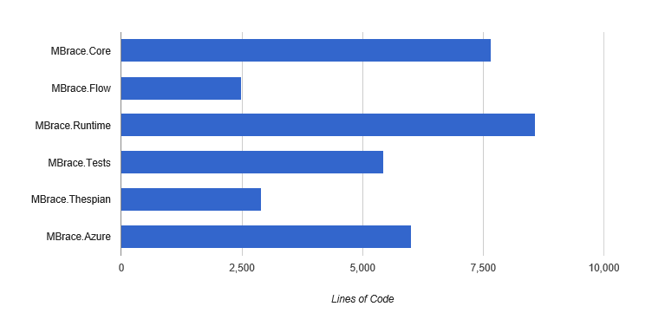
Lean and Simple

Slide 38
CloudFlow = Distributed Data Parallel F#

Slide 39
CloudFlow.OfCloudFileByLine
Partitioned data in the cloud
|> CloudFlow.map f
f
f
f
f
Your code, to ‘000s of machines, simply, transparently
|> CloudFlow.sumBy g
g
|> CloudFlow.persist

Slide 40
CloudFlow.OfHttpFilesByLine
Partitioned web inputs
http
http
http
http
|> CloudFlow.map f
f
f
f
f
|> CloudFlow.sumBy g
g
|> CloudFlow.persist

Slide 41
CloudFlow.OfCloudQueue
incremental queued inputs
|> CloudFlow.map
|> CloudFlow.averageByKey
incremental queued outputs
|> CloudFlow.toCloudQueue

Slide 42
CloudFlow.OfArray
v
local data inputs
|> CloudFlow.map
|> CloudFlow.averageByKey
|> CloudFlow.toCloudQueue

Slide 43
Demo – UK House Prices!
Isaac Abraham

Slide 44
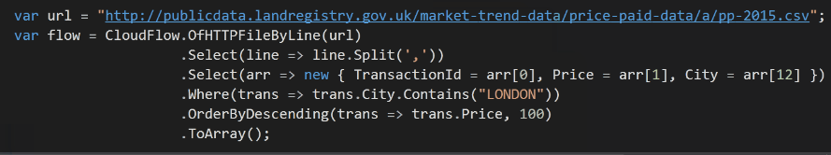
and from C# too!

Slide 45
Summary
F# community – fun, happy, creative and practical
Awesome Tech!
Suave, Docker, CoreCLR, MBrace, Akka.NET, Paket, FAKE, and much more
F# - the right design for the web and cloud
Join us!

